Slide 1
Scout Fair 2020 TEE IT UP WITH SCOUTING
April 4, 2020
Notes:
Welcome and Introduce your self
After the meeting we will be sending out this powerpoint!

Slide 2
Tee it Up With Scouting
We are excited to announce
TOPGOLF
as the 2020 partner
TOPGOLF will provide the weekly drawing prizes as well as the
220 Bonus Level Prize
1 Hour of Bay Time*
*Not valid after 5pm on Friday and Saturday, bays fit 5-6 comfortably
Notes:
This year we are excited to announce our partnership with TOPGOLF who will be providing the bonus prize for our top sellers and weekly winners. The prize includes one hour of bay time, not valid after 5 pm on Friday or Saturday. A bay comfortable fits 5-6. This would be a great opportunity for Top Selling Scouts with their friends or family.

Slide 3
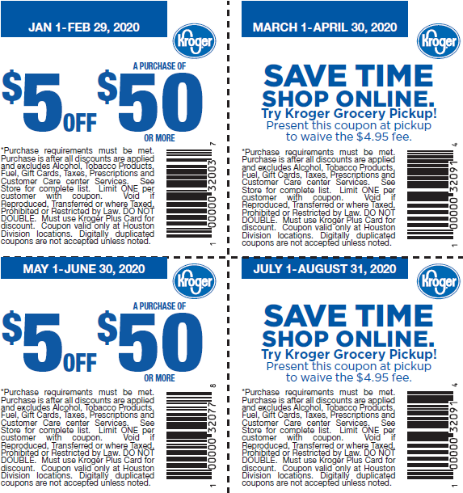
Changes to the Book
Notes:
We heard you! We added to the book. There are several new partners in the book this year. We focused on where families go and places that would hopefully help entice customers to support.
We again partnered with Kroger. Kroger generously is offering to IN STORE coupons along with two online coupons. Kroger is also allowing us to sell in front of certain Kroger stores, but more on that later.

Slide 4
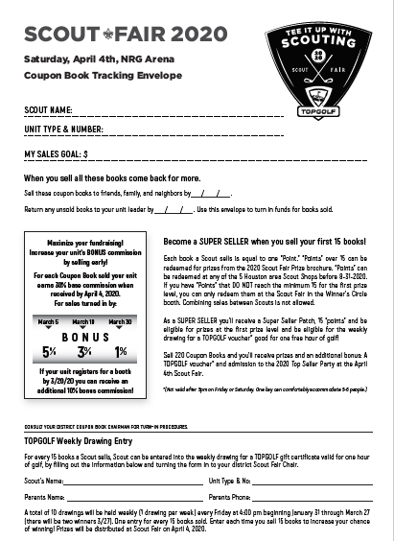
Tonight
You’ll receive
Scout Fair Coupon Books
Envelopes
Prize Brochures
Take this to your unit to have a Kick Off where you will distribute this to Scouts and GET THEM EXCITED about the sale and earning prizes
Notes:
Tonight we will be passing out all of the materials you need to kick of the sale with your unit.

Slide 5
How to Earn Money
Scouts receive books from their Unit
Scouts can sell Coupon Books to family, friends, neighbors, and in front of local stores
Unit Chairs should collect money sold from the books weekly to turn in
The earlier the money is turned in the more the unit earns
Notes:
Coupon Books are risk free. Tonight you will check out books. As the Scouts sell the books to friends, family, neighbors, and storefronts, you will collect the money and turn in. The earlier you turn in the profits the more commission the unit will receive.

Slide 6
Commission Structure
30% Base Commission on all money turned in before April 4th
March 5, 2020 – Coupon Book Sales - 5% Bonus turn-in deadline
March 19, 2020 – Coupon Book Sales - 3% Bonus turn-in deadline
March 20, 2020 – Booth Sign Up Deadline – 10% Bonus Commission
March 30, 2020 – Coupon Book Sales - 1% Bonus turn-in deadline
April 4, 2020 – Scout Fair!
10% base commission ONLY on monies turned in April 5th – 9th
5% base commission ONLY on monies turned in April 10th – 16th
No base commission earned on monies turned in after April 16th
Notes:
Commission Breakdown
30% Base Commission for all money turned in on or before April 4th. 10% Addition Commission if your unit participates by hosting a booth at Scout Fair. The earlier you turn in the more money back the unit will earn.
3/5/2020 – 5%
3/19/20 -3%
3/30/20 – 1%
At the end of the sale the number of books checked out to the unit must equal the amount of money turned in/ books returned/ or a combination of.

Slide 7
Organizing your Unit’s Sale

Slide 8
Keep Track of Scouts with Books
Check out the Scout Fair Section of the SHAC Website for Useful Leader Tools
Notes:
It is important to keep track of which Scout has how many books, and how much money each Scout has turned in. There are some tools on the council website that will help you with this. It is important for the parents of the Scouts to understand that either the books or the money (or a combination of the two) need to be turned back into you as the unit chair.

Slide 9
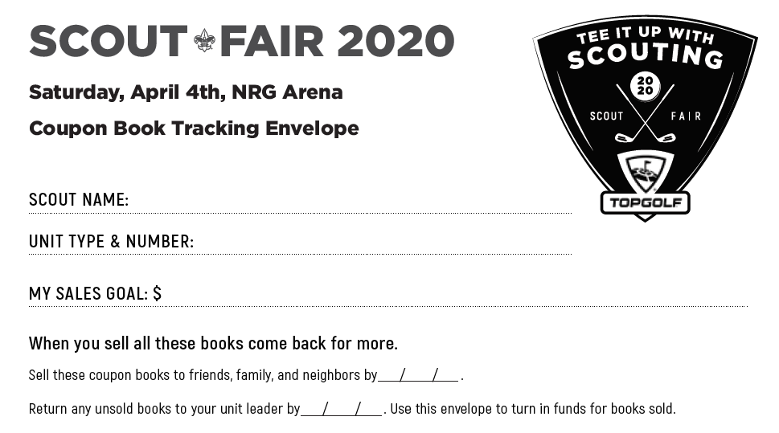
Check Out Books to Scouts
Notes:
The envelopes are designed so that you can check out 15 books to each Scout. Once the Scout has sold the 15 books, they can return the envelope with the money and you can take their information to register them as a “Super Seller”
Once they turn in the profit fro their first 15 books you can reissue more to them.
The envelope has a place for Scouts to write down their goals and a place for turn in deadlines for parents.

Slide 10
Unit Payouts
Commission is based on when money is turned in
To be “closed-out” every book must be accounted for
Either money turned in or books returned
If a unit is closed out on the 1% deadline the unit check will be available upstairs at Scout Fair. Proper ID is required to pick up
If a unit is not closed out by the 1% deadline the commission check will be mailed to the committee Chair ON FILE
Replacement checks requested will require a processing fee paid by the unit
Notes:
How your unit gets paid?!
Once the unit is “Closed out” meaning every book issued out has been accoutnign for either as money turned in or books returned, the council will issue the unit a check for the correct commission. Checks will be made out to the unit and the committee chair ON FILE. If your unit “Closes out” on or before March 30th (the 1% turn in), we commit to having the check available for pick up at the Scout Fair. Checks will be available at the Fair from 10am-2pm upstairs at the Scout Fair.

Slide 11
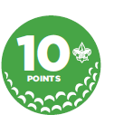
Motivation for Scouts
1 Coupon Book = 1 “Point”
“Points” = Prizes
Notes:
“Points” can be redeemed at one of the five Houston area Scout Shops before August 31, 2020 or at the Scout Fair in the “Winner’s Circle” Booth.
“Points” that DO NOT reach the minimum 15 prize level, you can redeem them at the “Winner’s Circle” ONLY at Scout Fair on April 4th

Slide 12
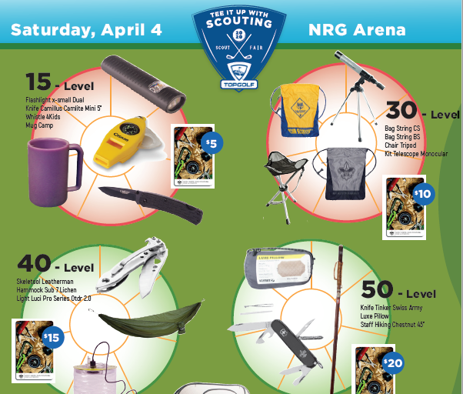
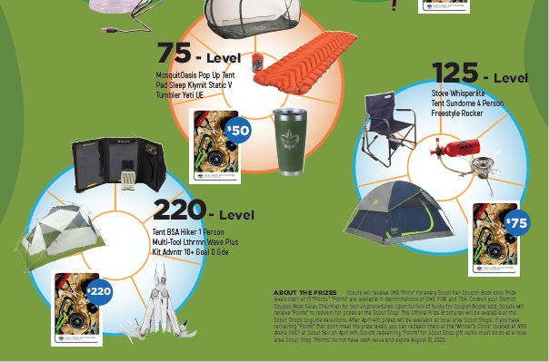
Prize brochure
Prizes
Redeem points for prizes at any of the 5 Houston Area Scout Shops before August 31, 2020.
Scouts that don’t reach the 15 Point level may redeem their “Point” at the “Winner’s Circle” Booth only at Scout Fair. No combining of points.
Notes:
Points are not able to be redeemed at the Scout Shop at the Scout Fair – there will be a Winner’s Circle booth that will have prizes for points. There is a limited supply. But Scouts can redeem points until August 31st at any of the five area Scout Shops. No points can be redeemed at the Scout Shop after August 31st, per the agreement with the Scout Shop.
For Scouts who do not have 15 or more “Points” they may be redeemed only at Scout Fair, for smaller prizes.

Slide 13
Weekly Drawings
Enter each week when you sell 15 Coupon Books
TO ENTER:
Fill out the bottom portion of the turn in envelope and turn in at the weekly turn ins to your District Executive or emailed to
krogersales@shac.org
DRAWING every Friday at 4PM
Winners will be announced on the Scout Fair Facebook page
Use money turn-in envelope for entry
Envelope is also available online
Drawing prizes will be distributed at Scout Fair upstairs at the Top Sellers Table. Winners will be contacted.
Notes:
As another way to encourage Scouts to sell. TOPGOLF has agreed to a 1-hour bay time voucher to one lucky winner every week. Scouts must have sold 15 coupon books to be eligible to win. To be entered into the drawing we ask that you as the Unit Coupon Book Chair verify that the Scouts sold the 15 books and either turn in the envelope submission forms at the weekly turn ins or by emailing in a digital copy of photo of the entry to krogersales@shac.org
Winners will be contacted directly to congratulate them and announced on the Scout Fair Facebook Page.

Slide 14
220 Top Sellers Celebration
Special party held at Scout Fair for Scout who sell 220 Coupon Books or more
A “TOPGOLF” Voucher from TOPGOLF
Additional prizes!
The Top Three Council Sellers will be announced
THIS COULD BE YOU
Top Seller
2020 Top Seller
Notes:
At the Scout Fair there will be a special celebration for Scouts who sell over 220 books. At this celebrations Scouts will receive their Top Golf Certificate along with other prizes, and the Top selling Scouts will be recognized.
220 Top Seller Scouts must register on doubleknot to be recognized as a 220 Top Seller. The deadline to register as a Top Seller is March 31st.

Slide 15
Where to Sell
Scouts can sell ANYWHERE
(Kroger is limited)
Scouts can sell where they sold Show N Sell Popcorn
Charter Organizations
Door to Door
Friends and Family
Notes:
We sold over 1 million dollars worth of Show N Sell Popcorn not at Kroger's…. places are out there!
Don’t forget about springtime fairs, community events, places that are in the book, your chartering organization

Slide 16
Tips for Asking Stores
Bring your Scout with you
(have your Scout ask the manager)
Wear your (leader) uniform
Ask the manager after patronizing the store
Be polite and follow the Scout Oath and Law no matter the outcome of the ask
If permission is granted, get details on expectations and then follow them
Council can provide a certificate of liability insurance if needed
Always say “THANK YOU”
Notes:
If you are asking a new Store remember to follow the Scout Oath and Law. If possible have your Scout with you when you ask, or have your Scout make the ask. The worst answer you can get is “no” but if you don’t ask then you will never get a “yes”
Remember that you represent Scouting no matter where you are selling.
Always say thank you!

Slide 17
Reserve your selling time at….
Notes:
Korger has partnered with us again this year. Allowing us to selling Infront of some of the stores.
It is a unit’s responsibility to verify (within 24-48 hours) of having a location that the location is confirmed
While not required it is encouraged that units stay within (or close to) Scouting district boundaries

Slide 18
….for Krogers
Coupon Book Selling Guidelines on the council website
Get the Genbook App for easy booking!
While making an appointment please use your real name (first and last).
One person per unit, not per den or patrol.
That one person should only make appointments for ONE unit.
(i.e. John Doe should not make appoints for both Pack and Troop 0000)
Notes:
If you have a question about a location sign-up then ask
Make sure that the unit coordinates ONE person within the unit to do the sign-ups. Otherwise sign-ups maybe cancelled due to a unit signing up for too many locations
Only 4 sites per unit until 2/2/2020

Slide 19
Kroger Dates

Slide 21
Detailed Kroger Explanation
This is the ONLY way to sign up to Sell Coupon Book at Kroger stores on designated dates/times
Do NOT ask Kroger employees/management about selling but DO THANK THEM for allowing us to be there.
Registration link opens at 12:00PM CT (Noon) Friday, January 24, 2020
Link will be posted first on the Scout Fair Facebook page and also http://www.samhoustonbsa.org/scout-fair-leader-page
You will receive an instant email saying, "your appointment is confirmed", it is not confirmed, appointments can still be canceled
Units must monitor appointments
Notes:
As you register for booths selling at Kroger you will receive an automatic confirmation email from GenBooks. If the unit signs up for too many slots, some of the appointments may deleted. It is important that you check the bookings before you set up the booth.

Slide 22
Kroger booths will be scheduled in four-hour blocks.
Each unit will be permitted up to four Kroger booths during the initial registration period (1/24/20 – 2/2/20).
Units who do not follow this policy will have their registration deleted.
After February 2, 2020, at 11:55 pm, units can register for additional booths.
If a Kroger is not listed as a sign-up location the store manager opted out – instruct units to NOT approach the store.
If a unit believes another unit is at a Kroger during their time slot, DO NOT approach Kroger Management. The correct unit will have a Gen Book confirmation for the time and location.
Notes:
We have partnered with HEB for other events hosted by the council.
Kroger booths must be scheduled through GenBooks. Selling “booths” are scheduled for four-hour blocks at a time. We have two-week blocks at a time, and share the selling period with the Girl Scouts.
From January 24th at noon until February 2nd every unit will be allowed to sign up for FOUR (4) slots. If a unit signs up for too many, their registration will be deleted. If a slot is deleted, you will receive an email stating it was canceled.
If you don’t see a Kroger store on the sign up, that store has opted out. DO NOT contact the store manager directly.
If a unit believes another unit is at a Kroger during their time slot, DO NOT approach Kroger Management. The correct unit will have a Gen Book confirmation for the time and location.

Slide 23
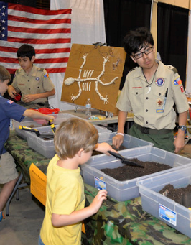
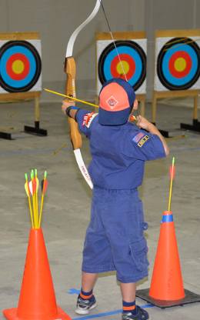
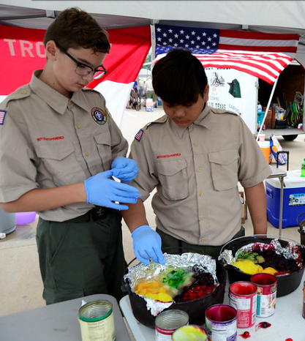
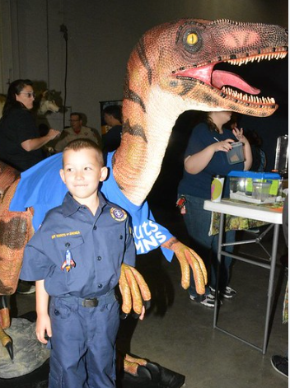
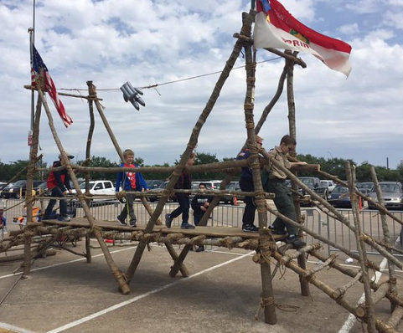
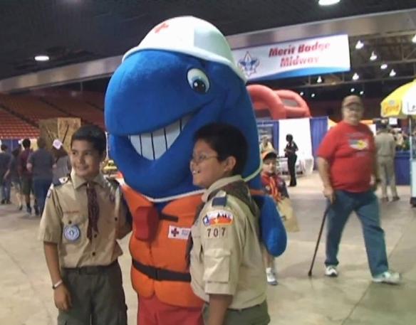
Participation
Scout Fair
April 4, 2020
NRG Arena
10:00 AM – 3:00 PM
Notes:
The Event! Scout Fair will be held at NRG Arena on April 4th. If you have never been to Scout Fair I would like to invite you to come out and either have a booth or just experience the Fair. Scouts from all over the council will be coming together to show off Scouting skills, cooking, working on belt loops, playing games, and having fun. There are also community partners like TOPGOLF, along with area parks and museums, aquatic groups, STEM organizations, and so much more.

Slide 24
Participation Booth Information
FREE Booth Space
Bring tables / chairs - or – rentals are available to purchase during booth registration
Purchase:
Electricity $110
$15 Parking Passes (In/Out Privileges and works for troop trailers too)
Register for a booth by March 20th to receive 10% bonus commission
Sign Up Here
Notes:
Booths are free. Let your youth show off something that they love to do as a pack/troop. Simple carnival style games are some of the best booths around! Reach out to
For troops do not forget to get a parking pass for the vehicle pulling the troop’s trailer. Otherwise both vehicle AND trailer will be charged.

Slide 25
Scout Fair Participation Patch
For all Scouts that sell, participate or attend Scout Fair!
Distributed on Scout Fair Day!
Notes:
For all Scouts that sell, participate or attend Scout Fair!
Distributed on Scout Fair Day! At the Fair your District Executive will have the patches. It will be important to know how many Scouts participated in the sale so they can get you the correct number of patches.

Slide 26
Upcoming Important Dates
1/24 – Kroger Booth Registration Opens @ noon
3/5 – 5% Turn In Deadline
3/19 – 3% Turn In Deadline
3/20 – Scout Fair Booth Registration Deadline (10% Bonus Commission for participating with a booth)
3/30 – 1% Turn In Deadline
Contact your District Scout Fair Chair or District Executive with any questions
Notes:
Dismiss to get supplies.

